Slide 1
Web Application Performance From User Perspective
Foundations of software testing
Jacek Okrojek
26.11.2015

Slide 2
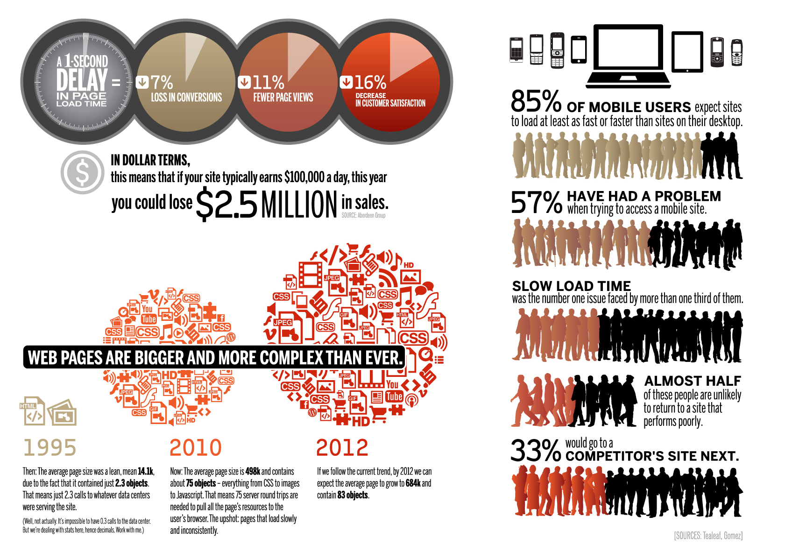
Consequences of poor performance
Web Application Performance From User Perspective

Slide 3
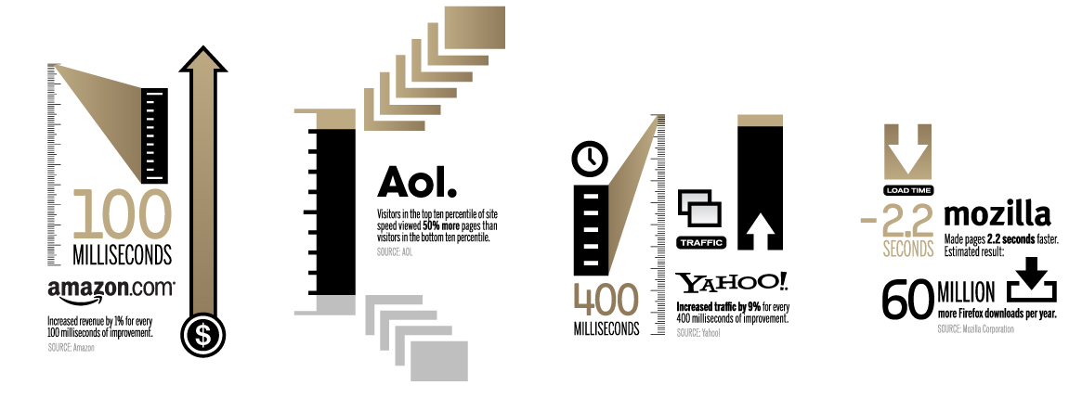
Benefits
Web Application Performance From User Perspective

Slide 4
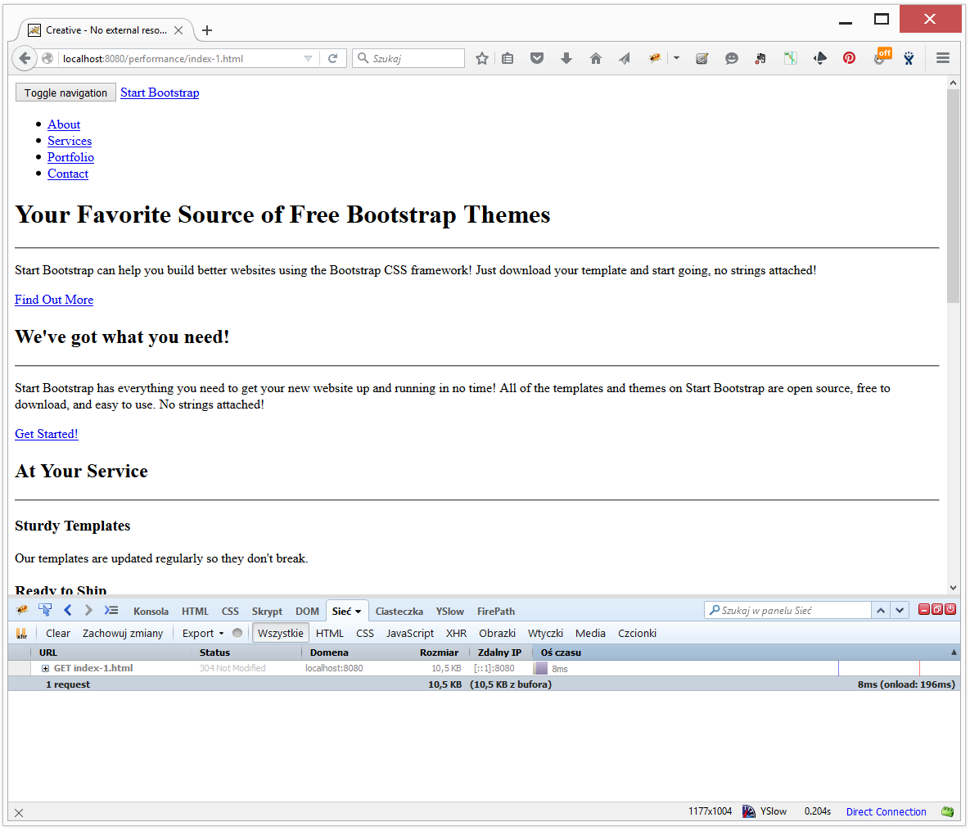
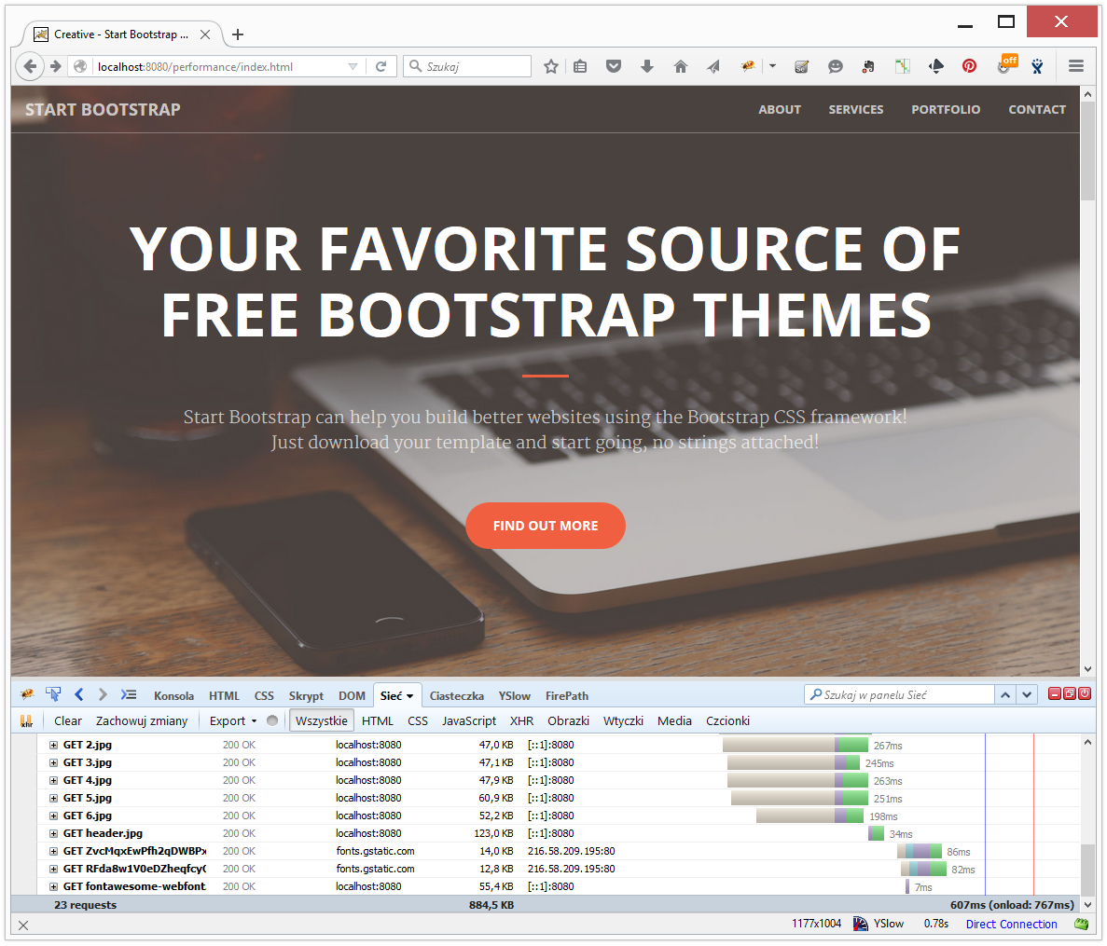
Performance tests with JMeter
Web Application Performance From User Perspective
Getting results from applications like JMeter give us results as if the user visits page looks like in the exemple on the left (and even this is not fully true) however actual page looks like in the example on the right.

Slide 5
When load generators are useful
Web Application Performance From User Perspective
Generating load for capacity tests and as a background for synthetic measurements with browser
Fast feedback about improvements related to generating main html document
Checking stability of the environment
Example: downloading 6kb image every 5 seconds
During a day (100min from 15:30PM)
During night (960min from 6:00PM)

Slide 6

Before next step you need to know High Performance Web Sites rules
Web Application Performance From User Perspective
Gzip Components
Put StyleSheets at the Top
Put Scripts at the Bottom
Minimize HTTP Requests
Make JavaScript and CSS External
Use a Content Delivery Network
Avoid empty src or href
Add an Expires or a Cache-Control Header
Avoid CSS Expressions
Reduce DNS Lookups
Minify JavaScript and CSS
Remove Duplicate Scripts
Make AJAX Cacheable
Use GET for AJAX Requests
Reduce the Number of DOM Elements
Use Cookie-Free Domains for Components
Do Not Scale Images in HTML
Make favicon.ico Small and Cacheable
Configure ETags
Avoid Redirects
Reduce Cookie Size
Avoid Filters
No 404s

Slide 7
Exercise
Web Application Performance From User Perspective
Propose performance improvements to http://practiqa.pl/performance/standard/index.html page
Select one web application you build and find performance improvements

Slide 8
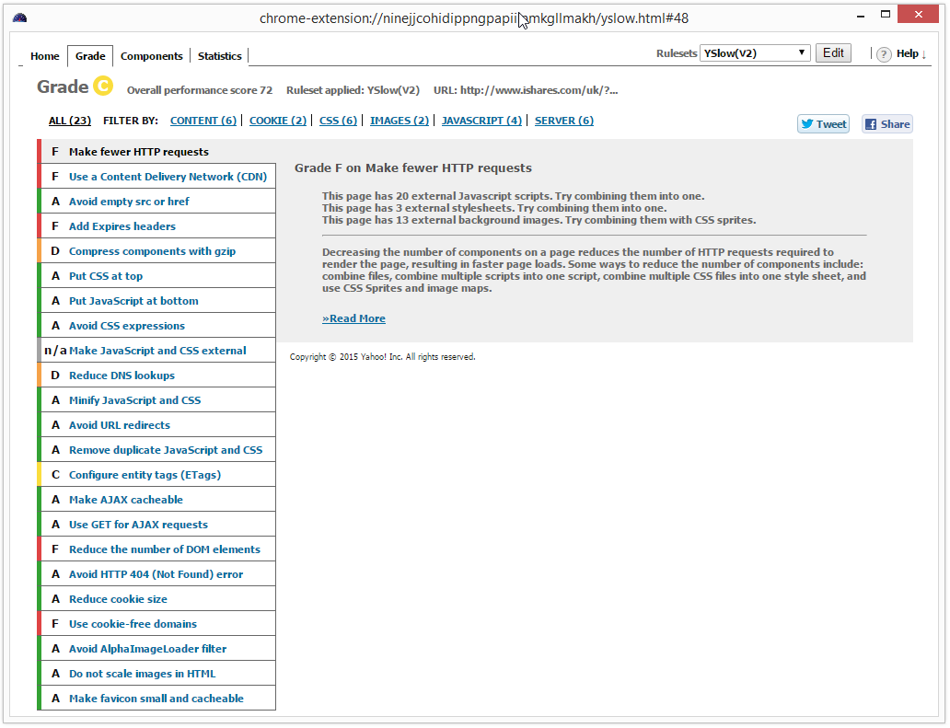
Checking conformance to High Performance Web Sites Rules
Web Application Performance From User Perspective
YSlow
Google PageSpeed
WebPageTest

Slide 9
Synthetic page load measurements
Web Application Performance From User Perspective
Synthetic page load measurements are collected with help of reference real browser
Used to monitor performance of production and test sites
Key advantages
You can run them when you want
Key disadvantage
Still you have approximation of performance seen from user perspective
Key challenges
What browser should be used
What hardware should be used
What connections speed should be used
What location should be used
What to measure

Slide 10
Tools and services for synthetic page load measurements
Web Application Performance From User Perspective
Open Source
Selenium with BrowserMob and Har Storage – tools for building custom tool that performs action and the web site and collects har files via proxy. Har Storage is a tool for storing har files and present performance trends out of them.
WebPageTest – collect measurements from various locations, browsers and connection seeds. It captures filmstrips, allows for scripting, heavy customization and calling via API
ShowSlow – daily checks for yslow results, integrates and can collects result with WebPageTest, public and private instances
SiteSpeed.io – tool that can crawl part or entire web site and collects yslow and performance measurements
Comercial services
NewRelic – affordable tool that can be used to synthetic and RUM measurements from various locations (AWS)
CatchPoint – gives you give insight into application performance from lots of locations around the world
Notes:
http://web.archive.org/web/20150405114023/http://ie.microsoft.com/testdrive/HTML5/DOMContentLoaded/Default.html)

Slide 11
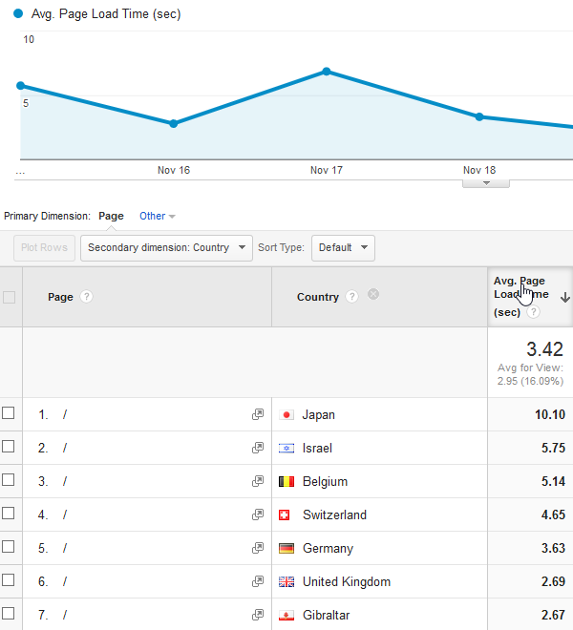
Real User Measurements (RUM)
Web Application Performance From User Perspective
Collected from real user devices (mobile and desktop) and helps understands how performance is seen by real users
Key advantages
You know what performance is seen by real users
Solves most of the challenges of synthetic monitoring
Key disadvantage
You can not run it when you want (for example before release)
Key challenges
What to measure

Slide 12
What to measure
Web Application Performance From User Perspective
First View or Repeated View (80/20 rule)
DOM Content Loaded or Page Loaded*
Speed Index **
Custom Event with Navigation, Resources or User Timing APIs***
<link rel="stylesheet" type="text/css" media="all" href="contentSearchUI.css">
…
<img src="hero.jpg" onload="performance.mark('hero1')">
<script>performance.mark('hero2')</script>
* http://web.archive.org/web/20150405114023/http://ie.microsoft.com/testdrive/HTML5/DOMContentLoaded/Default.html
** http://www.webpagetest.org/video/compare.php?tests=150912_EG_RPD,150912_96_RK5
*** https://www.youtube.com/watch?v=f5_iAzS3WMQ
Notes:
https://sites.google.com/a/webpagetest.org/docs/using-webpagetest/metrics/speed-index
http://www.webpagetest.org/video/compare.php?tests=150912_EG_RPD,150912_96_RK5

Slide 13



References
https://www.soasta.com/blog/measuring-web-performance-video/
https://dzone.com/articles/a-brief-history-of-web-performance-roi
https://developers.google.com/web/fundamentals/performance
http://yslow.org/
http://www.softwareishard.com/blog/har-viewer/
https://www.soasta.com/blog/ebook-usertiming-performance-monitoring/
https://codeascraft.com/
https://blog.twitter.com/2012/improving-performance-on-twittercom
http://www.stevesouders.com/blog/2015/05/12/hero-image-custom-metrics/#comments
https://www.soasta.com/blog/ebook-usertiming-performance-monitoring/
Steve Souders
@Souders
Ilya Grigorik
@igrigorik
Tammy Everts
@tameverts

Slide 14
GFT
Jacek Okrojek
Email: Jacek.okrojek@gft.com

